Slide 1
Thames Estuary 2100: Brief introduction & afternoon visits
Essex Coastal Forum
2nd July 2019
Mark Johnson, Kat Dedman & Phil Spearman
Environment Agency
Notes:
Aim of session: to discuss the key challenges and opportunities for smart city design that could be delivered along the Thames corridor. Outputs will include firm recommendations to include in relevant consultation responses and ideas for future collaboration and innovation.
Cantor Mocke, London Area Flood Risk Manager, Environment Agency. Cantor will give an update on flood risk
management in London and the Estuary including a review of TE2100 and feedback from some recent workshops on tidal flooding.
What are the key outcomes you would like to see on the river in 2050?
How do we use the river to shape a better quality of life in the Capital?
How do we integrate land with marine planning for sustainable development along the Thames?
How do we ensure net gain in environmental enhancement to deliver the Government’s aim of the 25 Year Environment Plan?

Slide 2
Introduction
Aims of the Thames Estuary 2100 Plan
Manage the risk of flooding to people, property and the environment
Ensure sustainable and resilient development in the floodplain
Adapt to the challenges of climate change
Protect the social, cultural and commercial value of the tidal Thames, tributaries and floodplain
Enhance and restore ecosystems, maximise environmental opportunities from realignment
Notes:
Mark
Intro to the Plan
The Thames Estuary’s most significant flood risk is from a tidal surge event. A world class system of defences currently reduces the risk of tidal flooding, including 9 major barriers, over 350km of walls and embankments, and over 400 other structures such as flood gates, outfalls and pumps. These work together with the Thames Barrier to protect London and the outer estuary in Essex and Kent from regular flooding from the sea.
Increasing pressures such as climate change and population growth mean that tidal flood risk will increase over time, unless this risk is carefully managed. The Thames Estuary 2100 Plan was developed to provide strategic direction for managing tidal flood risk to the end of the century, and was approved by Defra in 2012.
Designed to protect 1.3 million people and £275 billion worth of property and infrastructure from increasing tidal flood risk over the coming years
Aims of the Plan
The aims of the Plan are wider than just flood risk. It take a holistic view to managing flood risk whilst improving the riverside environment.
To manage the risk of flooding to people, and minimise the adverse impacts of flooding to property and the environment;
To adapt to the challenges that we will face from climate change;
To support and inform the land use planning process to ensure appropriate, sustainable and resilient development in the tidal Thames floodplain;
To protect the social, cultural and commercial value of the tidal River Thames, its tidal tributaries and its floodplain;
To enhance and restore estuarine ecosystems to contribute to biodiversity targets and maximize the environmental benefits of natural floods.

Slide 3
Introduction
Phase 1: Until 2035
Maintain and improve current defences, safeguard areas required for future improvements, monitor climate change indicators
Phase 2: Middle 15 years
Raise existing walls, defences and smaller barriers whilst reshaping the riverside environment
Phase 3: To the end of the century
Determine and implement an option for the future of the Thames Barrier, adapt other defences as required to work alongside this to protect the estuary
2010 - 2035
2035 - 2050
2050 - 2100
TEAM2100: managing tidal flood defences for the first 10 years of the Thames Estuary 2100 plan
Notes:
Mark
Roles & responsibilities
TE2100
Co-ordination of delivery across 3 phases [describe- Phase 1 includes monitoring indicators to inform 2020 review]
Including working in partnership with Councils responsible for delivery of certain elements through their planning and lead local flood authority roles
Strategic engagement
Governance etc.
TEAM2100- The programme started in 2014 and is being delivered jointly by the Environment Agency, Jacobs and Balfour Beatty, along with other suppliers. It is the UK’s largest single programme of flood risk management work, valued at over £300m in total, and is one of the government’s top 40 major infrastructure projects.

Slide 4
Riverside strategy approach
The Thames Estuary 2100 Plan promotes the riverside strategy approach
“to ensure that future changes to the riverside take place in a planned and integrated way which maximise the potential environmental, social, cultural and economic benefits.”
Lack of integration
Access and views restricted
Increased costs if opportunities missed
Lose opportunities for ecological enhancement/ regeneration
Deliverability issues
Notes:
Kat
What the riverside strategy approach is
It was introduced in the Thames Estuary 2100 Plan as a way for local planning authorities to create better access to the river and improve the riverside environment, whilst improving tidal flood defences. We want to work with planning authorities, developers and others with a planning remit, to implement this approach throughout the estuary.
Risks of not implementing it
Lack of integration- basic flood defence design
Deliverability issues- availability of land for raising/space for access for maintenance

Slide 5
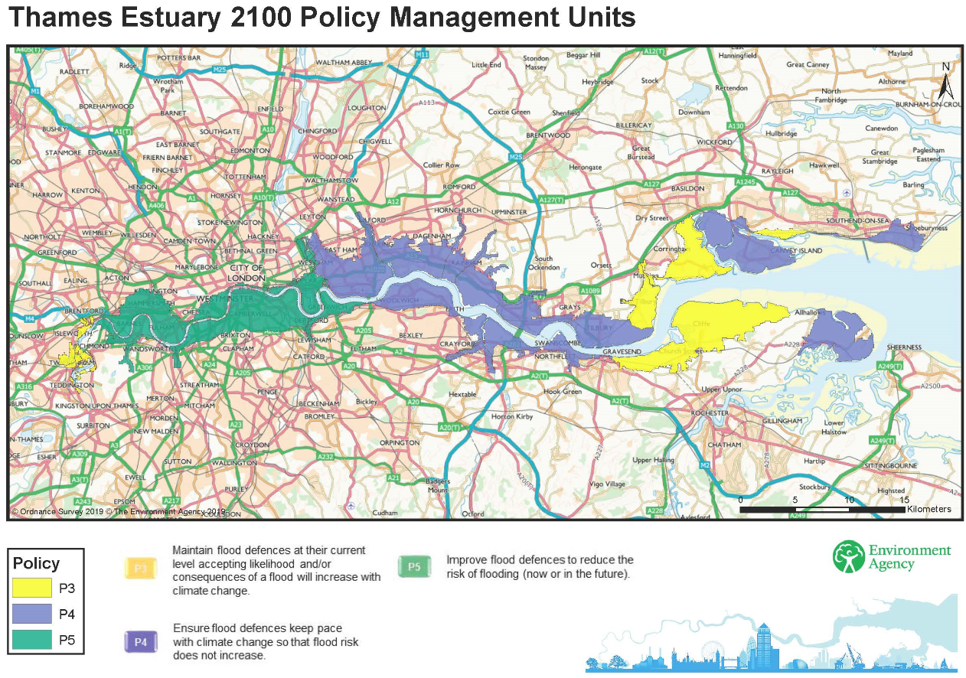
Grays riverside- 1st half of visit
Option 1.4- raising required:
0.3m (or greater locally) by 2040
Further 0.5m by 2070
Further 0.5m in 2100
Option 3.2- raising required:
0.3m (or greater locally) by 2040
Further 1.5m by 2070
Notes:
Kat
What needs to be considered
The Thames Estuary from Teddington to Sheerness/Shoeburyness is split into 23 PMUs based on similar characteristics.
The policies indicate the level of flood risk management which is justified by the people, the value of property and the other assets being protected in that area. The policies set the strategic direction of flood risk management in each part of the Estuary.
Purfleet Grays and Tilbury PU- P4- Take further action to keep up with climate change so that flood risk does not increase.
Option 1.4- Maintenance and enhancement, with modifications made to the Thames Barrier by 2070
Option 3.2- Maintenance and enhancement, and building a new barrier at Long Reach by 2070

Slide 6
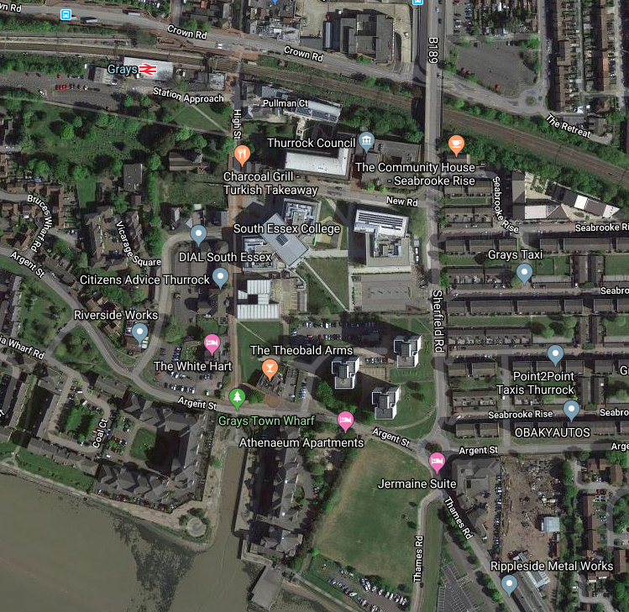
Grays Town Wharf
Current flood defence arrangement- relict floodgate
Challenges and opportunities through development
How this could be addressed
Notes:
Kat
Where we’ll be going
Relict floodgate below kept in-situ as part of the redevelopment and new tidal defence built to the landward side of the gate and gate itself kept in recognition of the site's operational past. Weight of infill behind has weakened the join- no impact on structural integrity. AP have spoken to the landowner and works will be planned to fix it- highlights need to think things through and the need for aftercare.

Slide 7
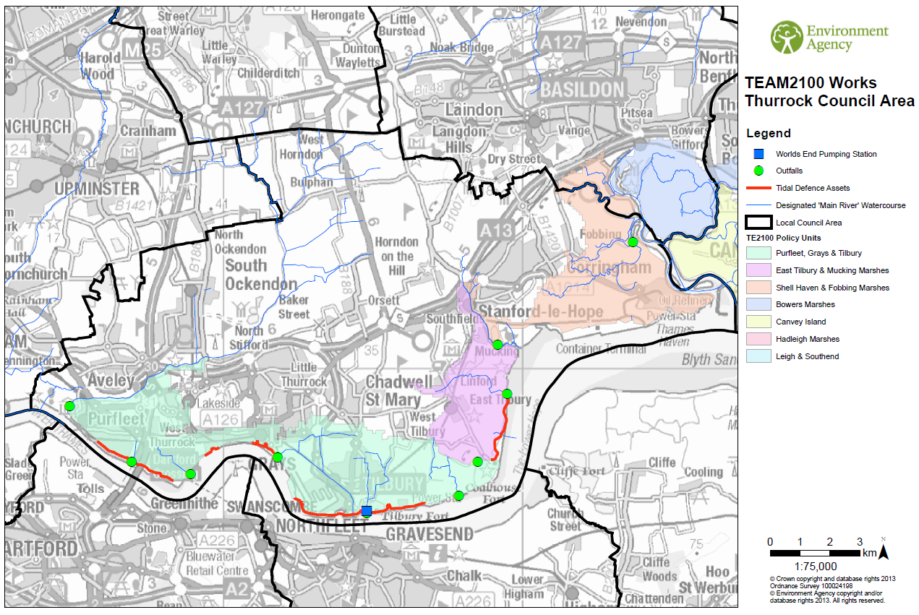

Slide 8
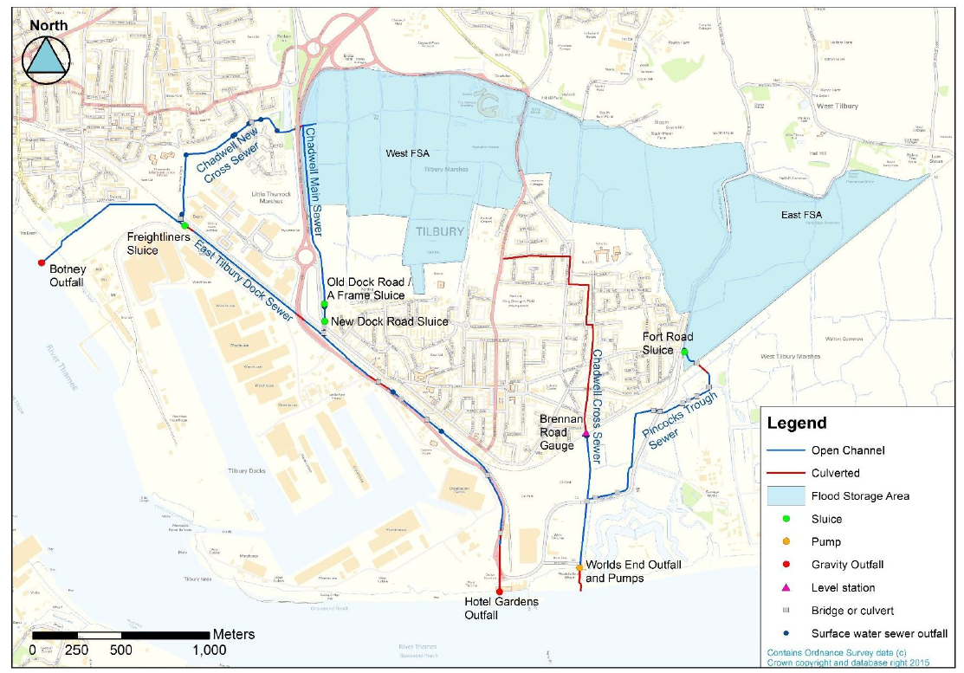
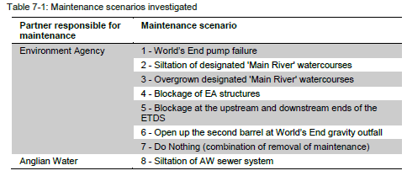
World’s End Pumping Station and Sluice
2nd half of visit
Approximate West-East split of the catchment
Benefits
Converted to a pumping station in 1962
Ensures a tidal 0.1% AEP to over 4,000 properties
Provides a 3.3%AEP from non-tidal sources to over 140 properties
Collects transport infrastructure drainage & including proposed Tilbury2 transport corridor
Serves land drainage routes from former power station area / Tilbury 2 site
JBA Consulting - Tilbury Integrated Flood Strategy (January 2017)
Notes:
TOM
The catchment is split into East and West Tilbury catchments. The East and West portions both have dedicated Flood Storage Areas (in blue on map shown) and their own operating rules for certain intensity storm events. The catchment is very flat for the most part, although higher ground in the north can lead to significant run-off rapidly entering the system. The flatness of the catchment means that there is minimal “lag” between World’s End PS and the town. This significantly restricts the operational parameters of the existing pumping station.

Slide 9
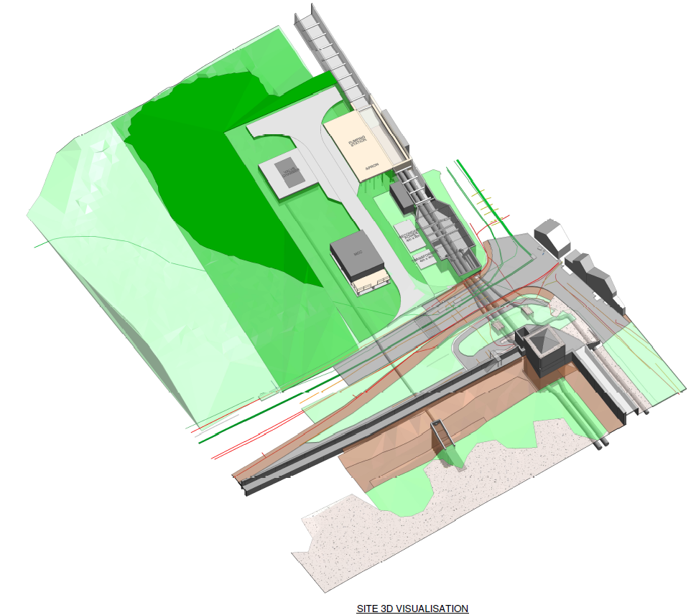
Proposed works include:
New wet well upstream of existing wet well
Connect Gravity outfall to existing
Backfill existing wet well
Same structure IL as existing
~£15m
Emerging EA Area staff preferred option

Slide 10
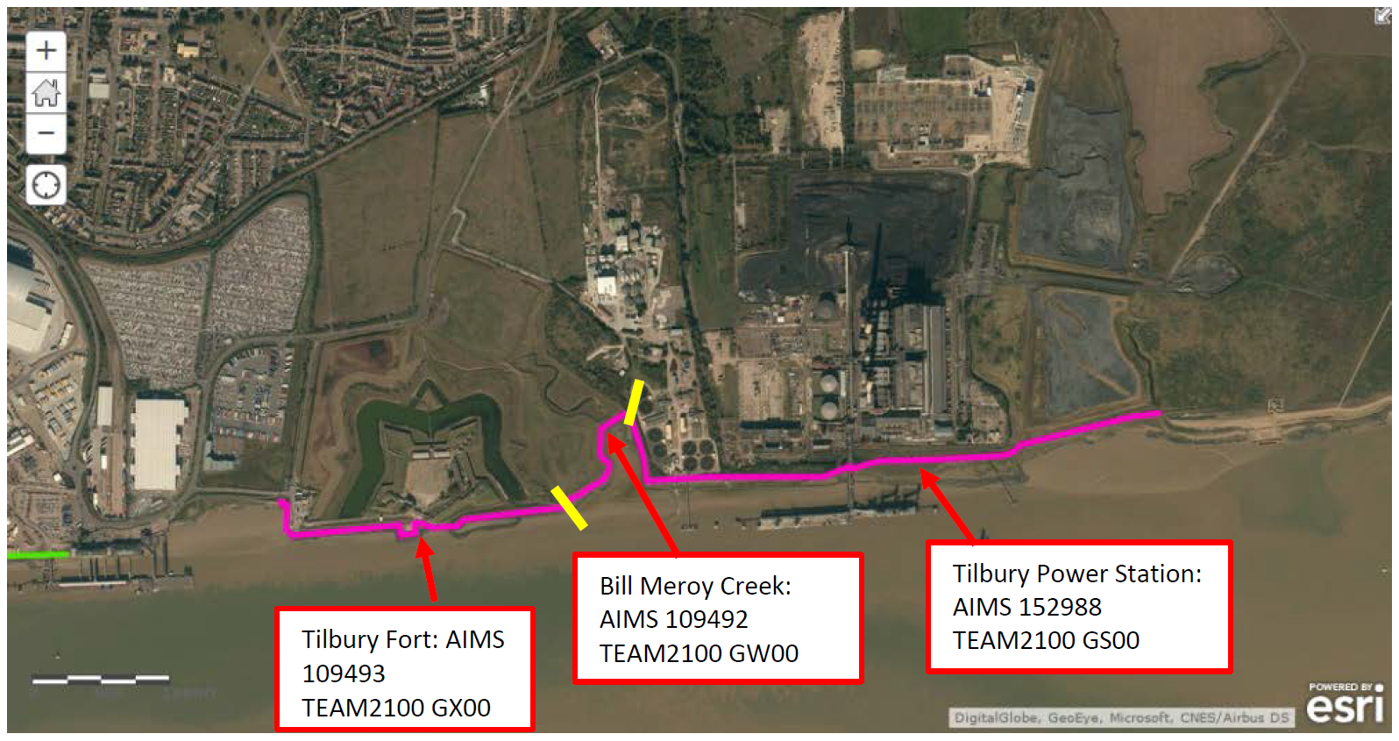
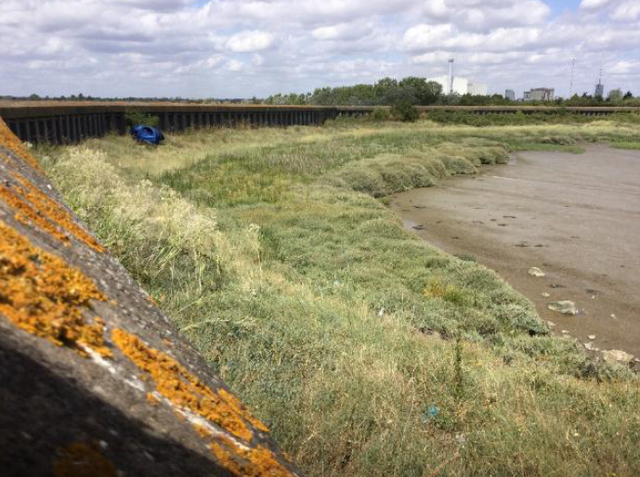
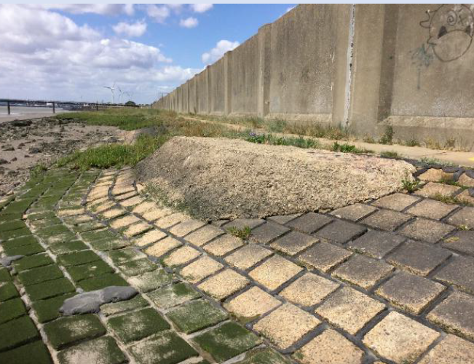
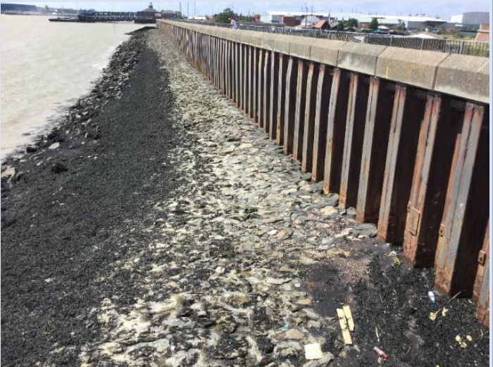
Tilbury Fort to former power station

Slide 11
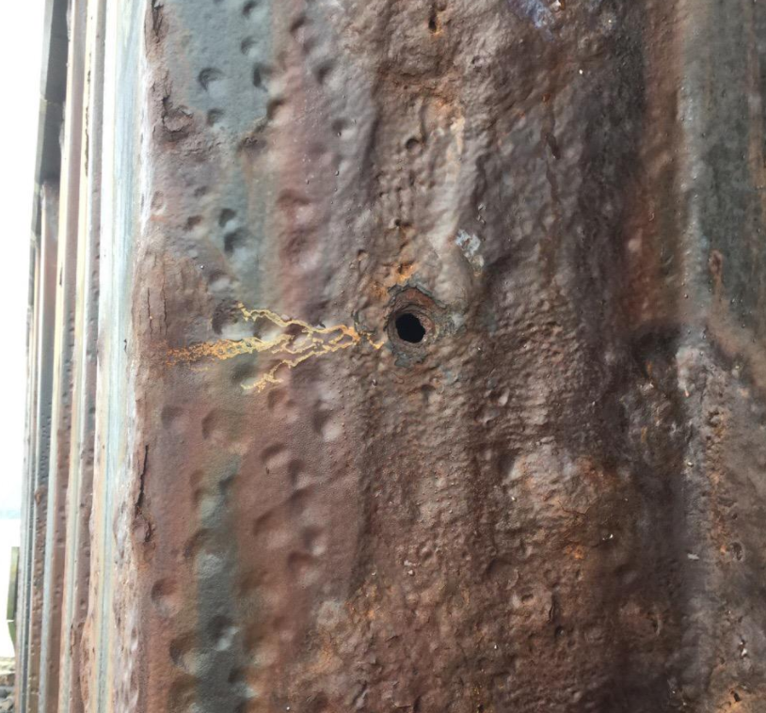
Tilbury Fort to former power station
Key Issues:
Differential settlement of assets
Corrosion & perforation of piles
Seepage through defence at Tilbury Fort
Displacement of foreshore revetment
Concrete Spalling
Notes:
DAVE
Tilbury Fort – Seepage and Pile Corrosion & Perforation
Bill Meroy Creek – Settlement
AW – Differential Settlement
PS West – Age, unknown foundation conditions, differential settlement, splitting and spalling
PS East – Differential Settlement and spalling
Bowaters – Settlement and erosion to foreshore
Star Dam – Settlement

