Slide 1
Essex Coast
Recreational disturbance Avoidance and Mitigation Strategy (RAMS)

Slide 2
The international importance of the Essex coast for wildlife

Slide 3
Overall Zone of Influence for Essex Coast RAMS

Slide 4
Impacts of Recreational Disturbance on Birds
Disturbance to wintering and passage waterfowl can result in:
A reduction in the time spent feeding due to repeated flushing/increased vigilance
Increased energetic costs
Avoidance of areas of otherwise suitable habitat, potentially with birds feeding at poorer quality locations
Increased stress
During the breeding season disturbance can affect breeding success as a result of desertion, trampling of eggs, increased predation rates etc.
Notes:
1. Disturbance has been identified by Natural England as a generic issue across many European Marine Sites (see Coyle & Wiggins 2010), and can be an issue for a range of species. During the winter/passage periods there can be high numbers of birds present, and competition for food and resources (Caldow et al. 1999; Goss-Custard et al. 2002, 2006; Stillman et al. 2007). Disturbance to wintering and passage waterfowl can result in:
A reduction in the time spent feeding due to repeated flushing/increased vigilance (Fitzpatrick & Bouchez 1998; Stillman & Goss-Custard 2002; Bright et al. 2003; Thomas, Kvitek & Bretz 2003; Yasué 2005)
Increased energetic costs (Stock & Hofeditz 1997; Nolet et al. 2002)
Avoidance of areas of otherwise suitable habitat, potentially with birds feeding at poorer quality locations (Cryer et al. 1987; Gill 1996; Burton et al. 2002; Burton, Rehfisch & Clark 2002)
Increased stress (Regel & Putz 1997; Weimerskirch et al. 2002; Walker, Dee Boersma & Wingfield 2006; Thiel et al. 2011)
During the breeding season the issues are different. Birds are usually tied to particular nest locations/territories. The additional stresses of territorial defence, egg laying and chick rearing mean birds are perhaps more vulnerable, and access levels are usually higher too (warmer weather brings more people to the coast).

Slide 5
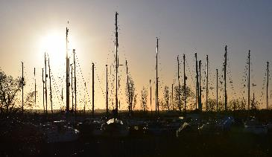
RAMS – A Strategic Approach
Operates more broadly than at a either a single LPA or single designated site
Preparation of a Mitigation Strategy is tied into the Local Plan timetable and HRA process
Helps to address overlapping zones of influence
Duty to Co-operate
Embedding nature conservation within sustainable development
Notes:
By developing a Strategic Solution
Strategic solutions are usually driven by challenges and opportunities arising from planning issues such as particularly complex, problematic or long running cases.
The development plan process provides huge opportunities to influence planning policy and create solutions that can filter down to the project stage, providing confidence that mechanisms exist to deliver much needed development in the right places whilst also ensuring the natural environment is fully considered. Can help with Duty to Co-operate issues where impacts of development cross into neighbouring LPAs
The Strategy is about embedding nature conservation within sustainable development, so that planning for growth and planning for the long-term maintenance of wildlife assets are fully integrated”
“we…consider that such an approach is the most effective and efficient means for planning authorities, developers and Natural England to ensure that housing growth is sustainably integrated alongside nature conservation in the long term”

Slide 6
RAMS – A Strategic Approach
Operates more broadly than at a either a single LPA or single designated site.
Preparation of a Mitigation Strategy is tied into the Local Plan timetable and HRA process.
Helps to address overlapping zones of influence
Duty to Co-operate
Embedding nature conservation within sustainable development
Notes:
By developing a Strategic Solution
Strategic solutions are usually driven by challenges and opportunities arising from planning issues such as particularly complex, problematic or long running cases.
The development plan process provides huge opportunities to influence planning policy and create solutions that can filter down to the project stage, providing confidence that mechanisms exist to deliver much needed development in the right places whilst also ensuring the natural environment is fully considered. Can help with Duty to Co-operate issues where impacts of development cross into neighbouring LPAs
The Strategy is about embedding nature conservation within sustainable development, so that planning for growth and planning for the long-term maintenance of wildlife assets are fully integrated”
“we…consider that such an approach is the most effective and efficient means for planning authorities, developers and Natural England to ensure that housing growth is sustainably integrated alongside nature conservation in the long term”

Slide 7
Benefits of a Strategic Approach
Time saving for authorities and other organisations/individuals involved
Secure strategic scale mitigation.
Compliance with the Habitats Regulations.
No surprises for developers- costs are known at plan allocation stage
Notes:
The benefits of a strategic approach for Essex coastal authorties:
Time saving and cuts down on unnecessary consultations at project stage.
Secures strategic scale mitigation, often breaking the stalemate of long running, complex high risk cases.
Ensures local plans are compliant with the Habitats Regulations.
Costs the mitigation up front at the local plan stage, developers are charged an agreed amount per dwelling – pooled pot

Slide 8
The Essex coast RAMS mitigation package
Education and communication
Provision of information and awareness raising e.g. rangers including volunteers, interpretation websites and social media
Habitat based measures
Fencing/waymarking/screening – direct visitors away from sensitive areas or provide appropriate screening to minimise impacts
Pedestrian and dog access – zoning, prohibited areas (usually seasonal)
Cycle access – promote appropriate routes
Vehicular access and car parking – opportunities for improving siting and ‘spreading the load’
Enforcement – ranger activities
Habitat creation – saltmarsh restoration, artificial islands etc
Partnership working – e.g. Natural England, RSPB, EWT National Trust
Monitoring and review – ongoing surveys

Slide 9
Delivering RAMS
Based on the likely costs of delivering the necessary mitigation measures split by the likely increased housing over a 20 year timeframe a tariff of £122.30 has been established
This tariff will be applied to any scheme which results in any net increase in the number of dwellings i.e. 1+
It is proposed that each of the 12 LPAs will collect the tariffs for each application within the Zone of Influence
The LPAs should be collecting the tariffs now to ensure compliance with their HRA duties
The RAMS steering group is considering how the process will be administered. The favoured option is for an accountable body. Chelmsford City Council is willing to take on this role subject to support with administrative costs

Slide 10
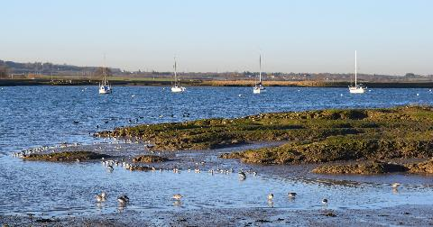
RAMS progress to date & next steps
RAMS Strategy Document completed & approved by 5 LPAs
RAMS SPD drafted, but legal opinion will likely result in changes
RAMS SPD Consultation sub-group met in June
Chelmsford have prepared a proposal to become the Accountable Body
EPOA Director’s Group are the Project Board, with final decision on annual project plan & spending priorities
Member involvement from the Essex Coastal Forum
Bird Aware Essex Coast website to be launched in September
Notes:
Place Services to project manage and prepare the Mitigation Strategy and a supplementary planning document – No capacity with in the LPAs to do this in house
11 Authorities have signed up to the strategic approach
Project management is well underway with a timeline and brief for the work established
11 authorities and NE have covered the cost of the visitor survey work- winter surveys will conclude this week & summer surveys are being explored now
Stakeholder workshops split north and south of the county with one round already taken place last week and a second round planned for early summer
NE have agreed an interim approach for Authorities in advance of the finalisation of the RAMS.

Slide 11
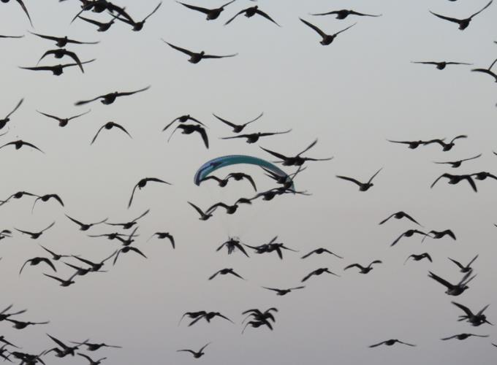
Questions???

