Slide 1

Peter Riches
Coastal Agent for Essex Suffolk and Norfolk since 1990
and the River Thames since 2013

Slide 2
The Crown Estate is a commercial real estate business, established by an Act of Parliament which can trace its roots back to 1066.
100% of its annual profits are returned to the Treasury for the benefit of the public finances.
Its portfolio includes:
  Management of the UK seabed, approximately half the foreshore and tidal estuaries;
  Regional retail and leisure assets;
  Rural and strategic land; and
  Central London, including Regent Street and around 50% of St James’s;
In the 21st century it is a successful, commercial enterprise known for a progressive, sustainable approach which creates long term value, beyond its financial return.

Slide 3
Why do we have a Crown Estate?
1066 - The Norman Conquest – All land vested in the Crown including the coast, needed to defend the nation. Presumption in favour of the monarch; exists today. Land used to raise revenue for sovereign’s fiscal responsibility – raise an army; fund the judiciary.
1760 - George III – The Civil List taxes raise revenue and country administered by parliament; HM Forests and Foreshores and the Forestry Commission. Managed by the Board of Trade
1961 – The Crown Estate Act – TCE manages land owned by The Crown. Established the Crown Estate Commissioners as managing trustees; distinguishes TCE from other Crown land eg MoD

Slide 4
What is The Crown Estate?
Not the Sovereign’s personal estate
Owned “in right of the Crown”
Governed by Act of Parliament – “work with the grain of government”
Managed by the Crown Estate Commissioners; the Sovereign has no management control
Revenues surrendered to the Treasury for the benefit of the nation

Slide 5
The Crown Estate’s title
Crown prerogative – prima facie title
Paramount lordship under the feudal system out of which freeholds are created
Demense land (with no lord) or the allodium
No deeds but since 2002 we register title

Slide 6
Parliament decrees that TCE operates
as a commercial organisation, combining the
commercial imperative with an equally firm
commitment to integrity and stewardship.
s1.3 - general duty to maintain and enhance its value and the return obtained from it, but with due regard to the requirements of good management
s.3.1 – no person can acquire an interest or occupy Crown land without paying the best consideration in all the circumstances

Slide 7
The Crown Estate ‘businesses’
Central London - mainly Regent Street and St James’s
Regional Retail – mainly out of town retail and leisure parks
Rural – 356,000 acres of farmland and Windsor Great Park
Energy Minerals and Infrastructure (EMI) includes the Coastal Estate
Scotland – now devolved to Crown Estate Scotland (the Scotland Act 2016)

Slide 8
What the EMI comprises?
  Energy & Infrastructure
    Offshore wind
    Wave & Tidal
    Carbon Capture and Storage
    Pipelines, outfalls and cables
  Marine aggregates – including salt and potash
  Coast and Estuaries

Slide 9
The Coastal Estate
55% of the UK’s foreshore - mean high to mean low water
the beds of many tidal rivers and estuaries - to natural tidal limits (normal tides)
Bed of the sea to the 12 nautical mile territorial limit
the rights to explore and utilise the natural resources (excluding hydrocarbons) of the UK continental shelf.

Slide 10
The coastal estate in East Anglia
Beaches (including the Wash)
Norfolk Broads – rivers only
Estuaries (excluding the Colne – Borough Charter 1189)
  Blyth
  Alde
  Deben
  Stour
  Parts of the Blackwater and Crouch and Roach
  5% of the tidal River Thames
Ports
  Felixstowe
  Harwich
  Gt Yarmouth Outer Harbour

Slide 11
Essex

Slide 12
River Thames
Fronting Crown land – Tilbury Fort, former royal dockyard at Deptford, Tower of London, Houses of Parliament, Somerset House, Greenwich, Woolwich Arsenal, Battersea Park, Kew Gardens, Richmond, Hampton Court
5% of tidal river - (95% PLA and Environment Agency – successors to the Thames Conservators)

Slide 13
What we do
Grant agreements (leases) for use of foreshore and bed to raise revenue and facilitate management
Moorings – fairway committees, clubs and associations
Reclamation eg Ports
Wildfowling – BASC and JTG
Conservation – Local Authorities, RSPB, NE
Pipelines, cables and outfalls

Slide 14
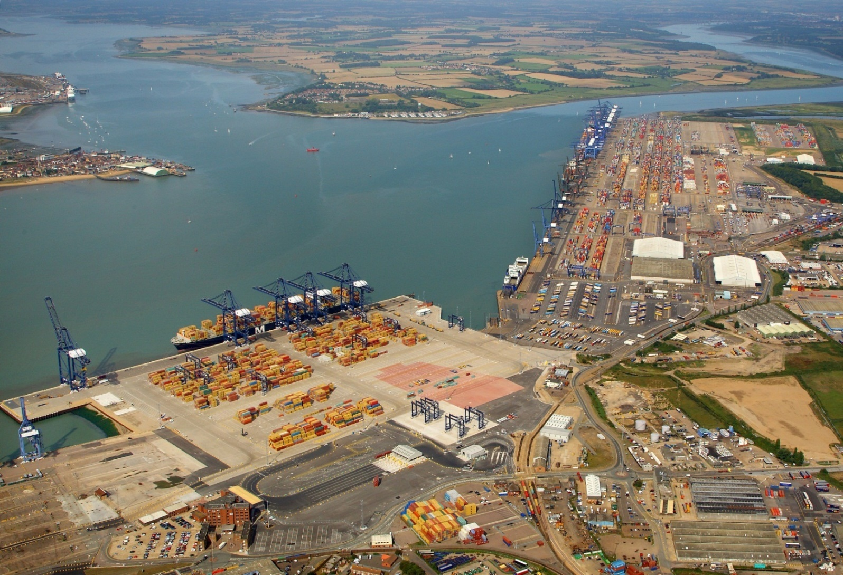
Ports - Felixstowe

Slide 15
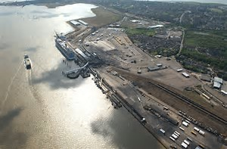
Harwich International Port

Slide 16
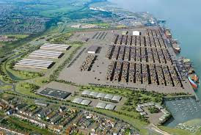
Bathside Bay

Slide 17
Tilbury 2

Slide 18
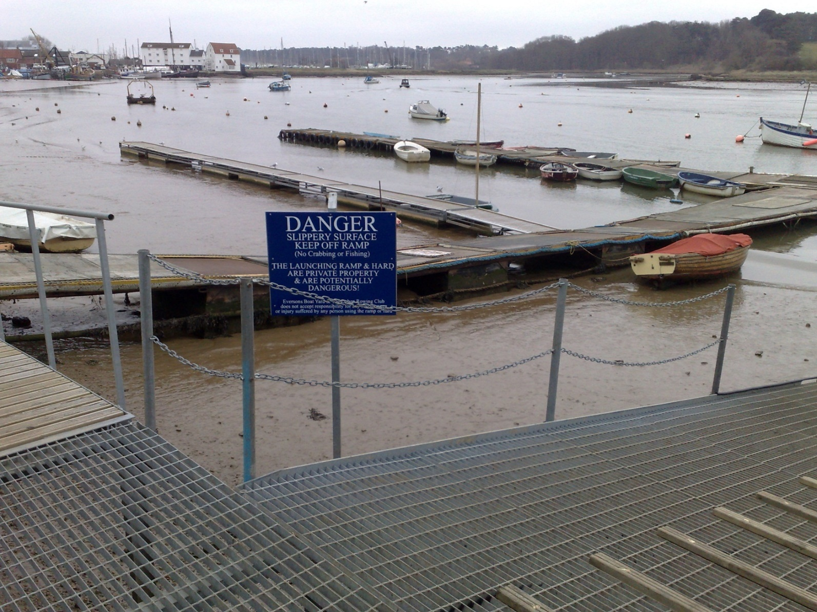
Moorings

Slide 19
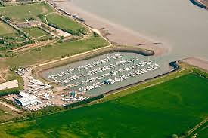
Burnham Yacht Harbour

Slide 20
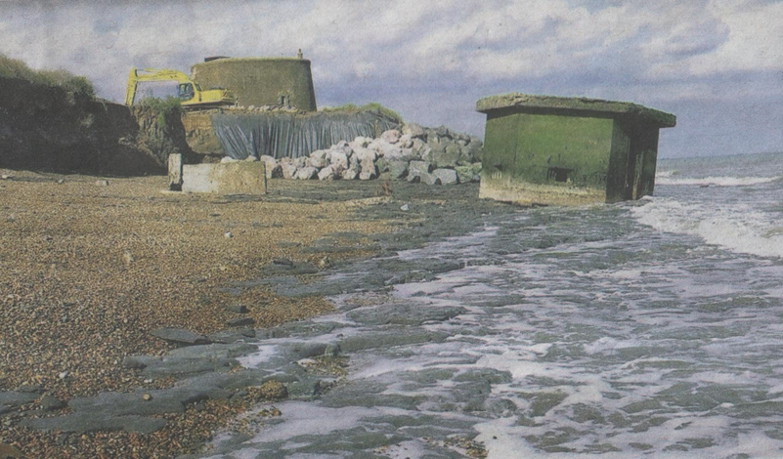
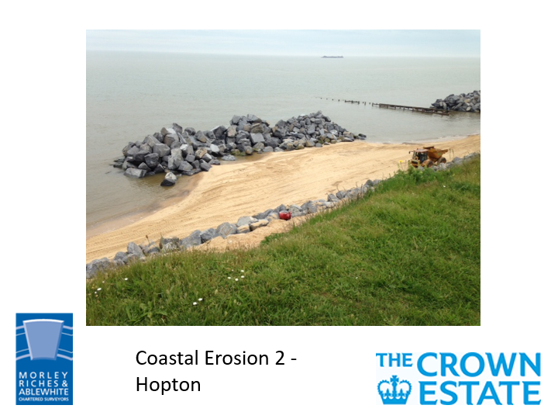
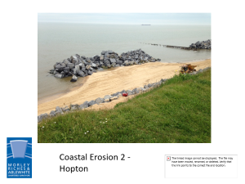
Coastal Erosion 1 - Bawdsey

Slide 21
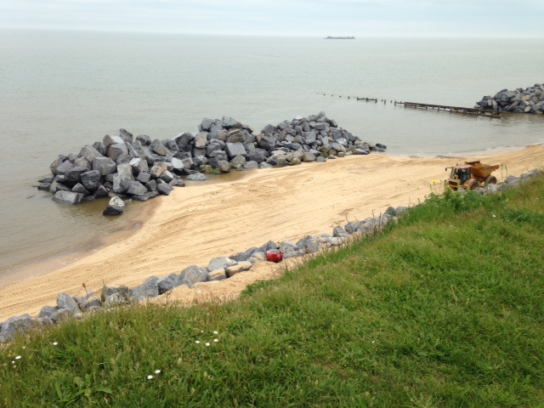
Coastal Erosion 2 - Hopton

Slide 22
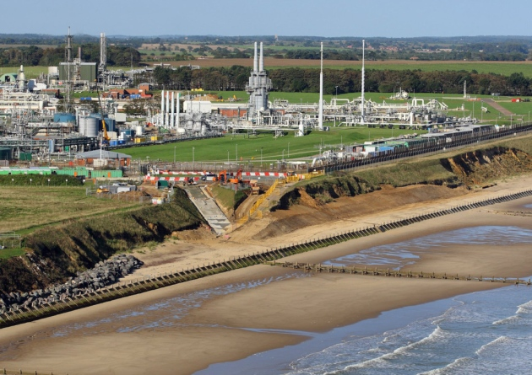
Coastal Erosion 3 - Bacton

Slide 23
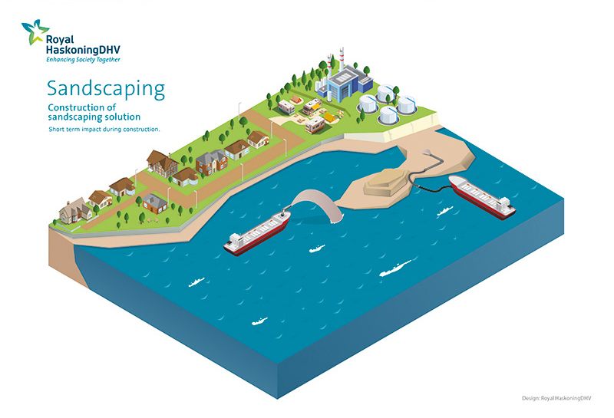
Sandscaping t.co/wh64ppLKVk

Slide 24
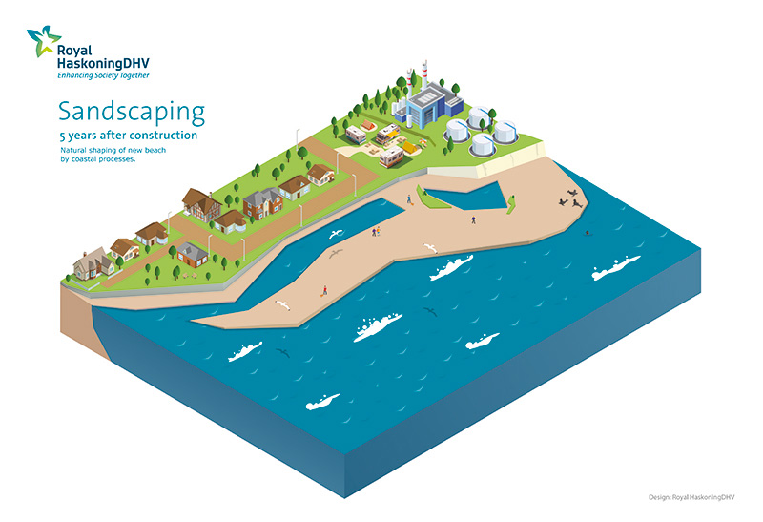
Sandscaping 5 years

Slide 25
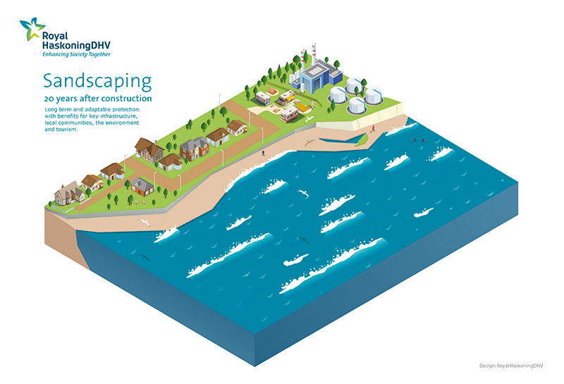
Sandscaping 20 years

Slide 26
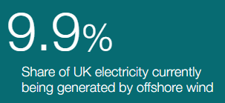
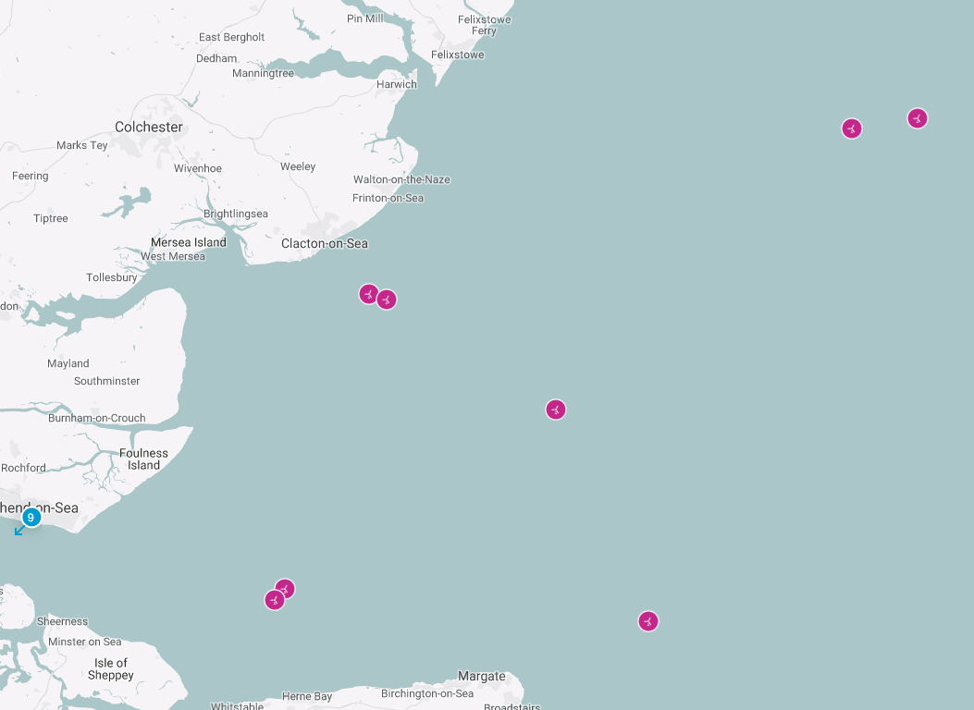
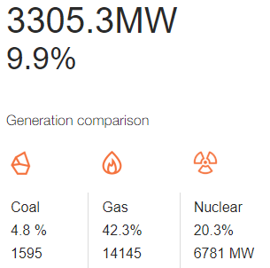
5 Nov 2019 – 8am
https://www.thecrownestate.co.uk/en-gb/our-places/asset-map/#tab-2

Slide 27
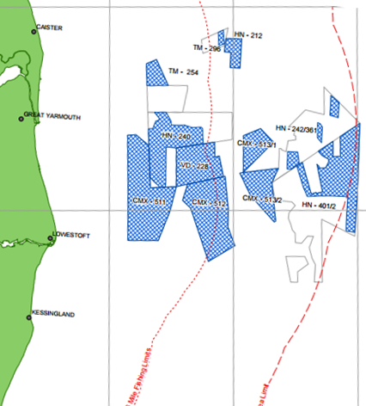
Offshore Aggregates
East Anglia 4.47m tonnes taken in 2015 (9.2m tonnes licenced)
Nationally – 19.5m tonnes taken

Slide 28
What is it worth?
£14.3bn - £343.5m surrendered to HM Treasury 2018/19 (£2.8bn in the last 10 years)
London - £8.2bn
Regional retail – £2.3bn
EMI - £1.6bn
Rural & Coastal - £1.4bn
  £46.7m to Treasury in 2018/19
  Coastal Communities Fund (HLF) set by Govt at 50% of revenue
March 2019

Slide 29
What we are not
Not a regulator
  EA, Harbour authorities, DoT, Defra etc
Not a planning authority
  District Councils, MMO
Not the Coast Protection Authority
  Local Authorities, Environment Agency
Not a conservation agency
  Natural England
  IFCAs
The Crown Estate is a landowner

Slide 30
Peter Riches
Morley Riches & Ablewhite
Kings Court, Newcomen Way
Colchester CO4 9RA
01206 505707
www.thecrownestate.co.uk

