Slide 2
December 2013 tidal surge
Mark Johnson – Area Coastal Manager
Essex Coastal Forum
25 February 2014

Slide 3
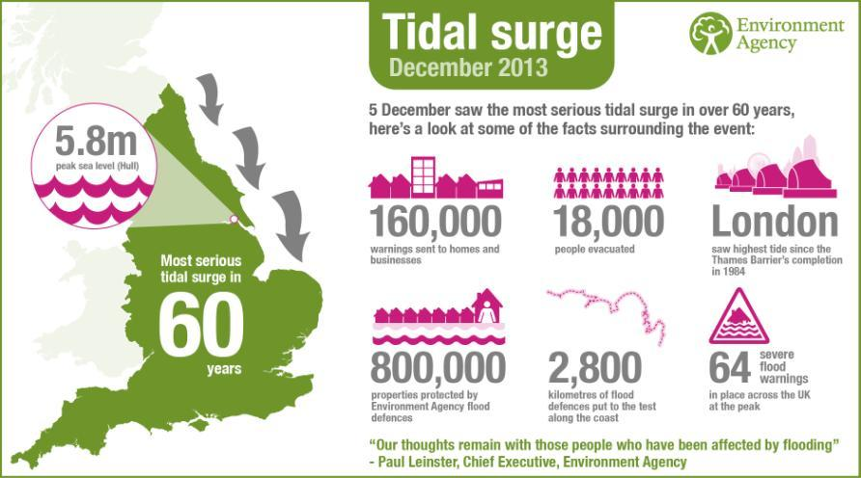
Summary
Notes:
Slide 3: Summary of the flood
Good overview of the headline stats from the East Coast surge. Put together by our Media and Corporate team.
Reflect scale of defences and what they were doing 2800k assets
64 SFW in place – in 2012 most at any point was 4
18000 evacuated - 9000 just in Great Yarmouth
Lessons, lots refused to go, response to St Jude
Worried about looting
160,000 warning
43,000 warnings in just one hour – testament to our warning service
1400 + flooded, but 800,000 protected including infrastructure
London – Thames Barrier operated 125th time – highest tide it has ever held back

Slide 4
Early indication of the storm
Monday 2nd December
Early indication of possible rather than probable storm
Tuesday 3rd December
Storm becomes probable. Partners advised.
Wednesday 4th December
Forecast tide heights for a significant storm.
SCGs formed in Norfolk, Suffolk & Essex
Thursday 5th December
Severe Flood Warnings issued at 0530hrs
Tide arrives in Wells next the Sea at 1915hrs
Notes:
Notes (DK)

Slide 5
Gearing up and working with our partners
Monday
Assessing our resources
Informal contact with LRF duty officers
Tuesday
Formal contact with all 3 LRF
RED Telecon
Wednesday
Deterministic predictions for a significant tide
Request SCG in each county

Slide 6
Formal Liaison Via SCG
Provision of liaison officers to all three Golds
Provision of storm forecast
Identification of areas at risk
Statistics on flooding (e.g. numbers at risk)
Interpretation of forecast and prediction of impacts
Maps
Flood Warnings and Severe Flood Warnings

Slide 7
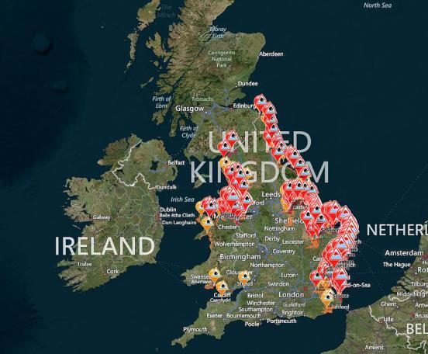
5 COBR meetings
43000 flood warnings issued in 1 hour (6 Dec)
19 incident rooms opened
15 Strategic Co-ordinating Groups (GOLD) meetings
64 severe flood warnings issued at peak
Response Coordinating Groups
3000 Environment Agency staff involved
14 National Operations Incident Management Team meetings
15 Strategic Management Team meetings
Notes:
Slide 9:
This is the slide that we produced to feed into the Common Recognised Incident Picture (CRIP) – so the flood warnings on this map are the current situation as at 6 December 14.00hours.
5 Cobr meetings (one officials)
15 Gold
Res CG
3000 EA staff involved
15 SMT meetings
14 NOIMTs
64 severe flood warnings at our peak (71 issued over all)
43000 flood warnings issued per hour at 0500 on 6.12.13
Amazing stats around our involvement for example, the largest number of COBR meetings ever attended, the most severe Flood warnings we have ever issued.
460,000 clicks onto our live flood map (25,000 from USA, 6000 Australia)
List of internal facts and figures on meetings
Big story around the world – 6m page views on our website in one day the highest ever.

Slide 8
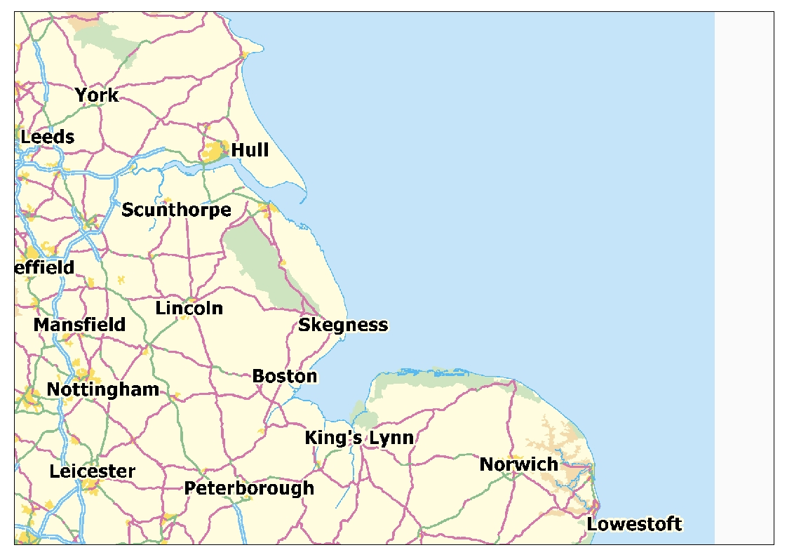
Leith
T-3:44
Scarborough
T-2:14
Tidal Timings
Immingham
T-0:26
Hunstanton
T
0000 hrs
Boston
T – 0:18

Slide 9
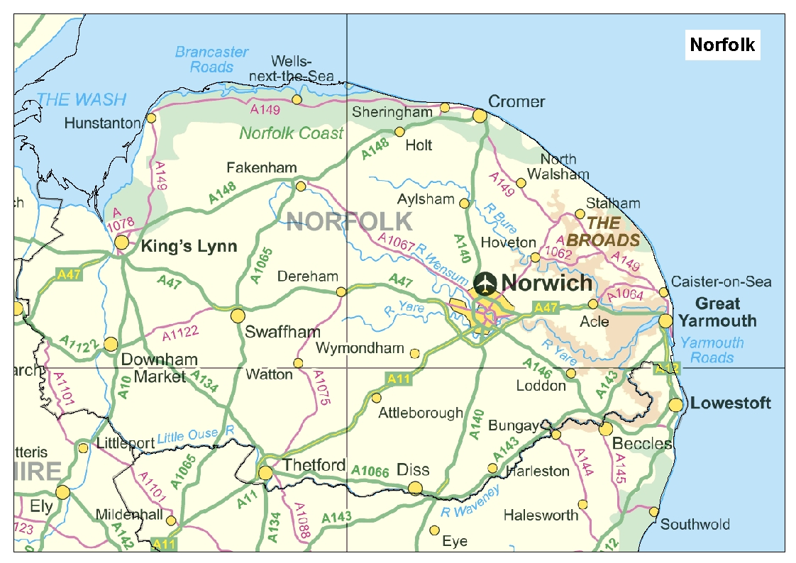
00:17
Wells
00:10
Cromer
00:00
Hunstanton
07:23
Stalham
00:04
King’s Lynn
00:49
Winterton
02:39
GT. Yarmouth
02:03
Denver
03:36
Acle
05:44
Brundall
03:04
Tidal Progression
03:39

Slide 10
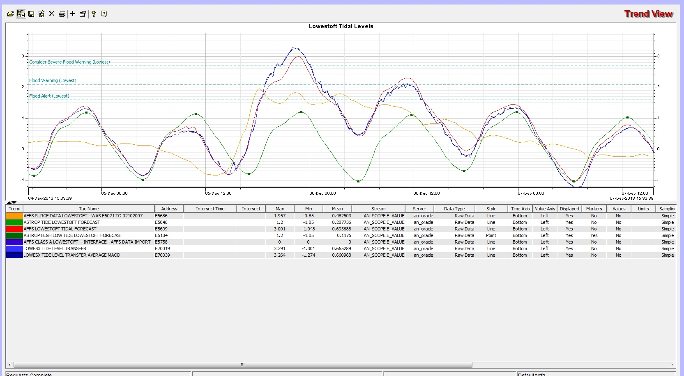
Notes:
Lowestoft telemetry gauge and level data showing the actual tides ahead of the predicted tides with the surge

Slide 11
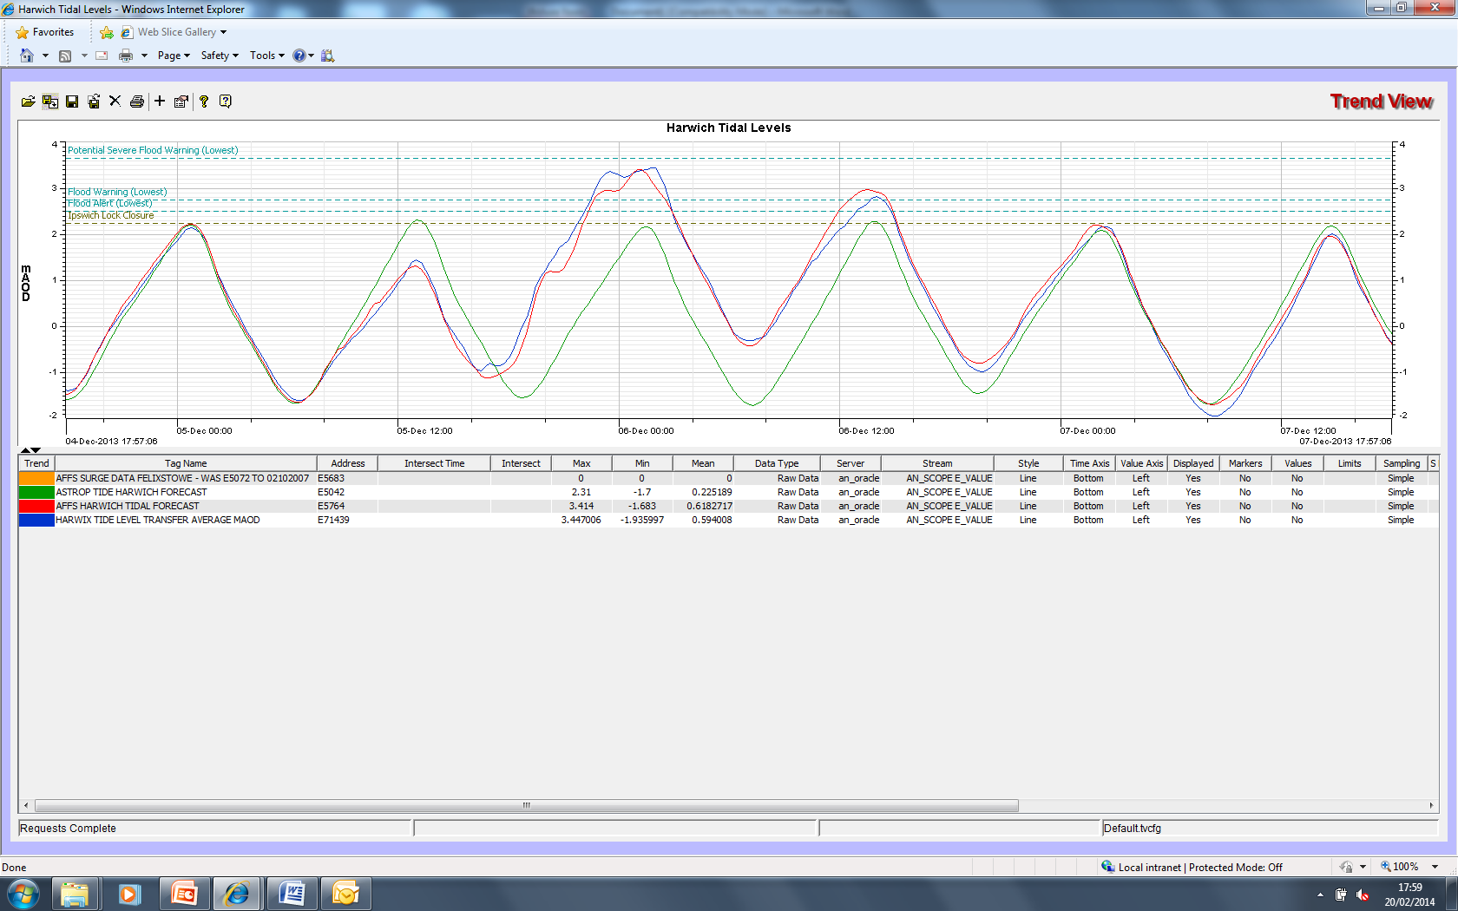
Notes:
Harwich telemetry data with actual levels coinciding with predicted levels and timings. (No predicted surge data available)

Slide 12
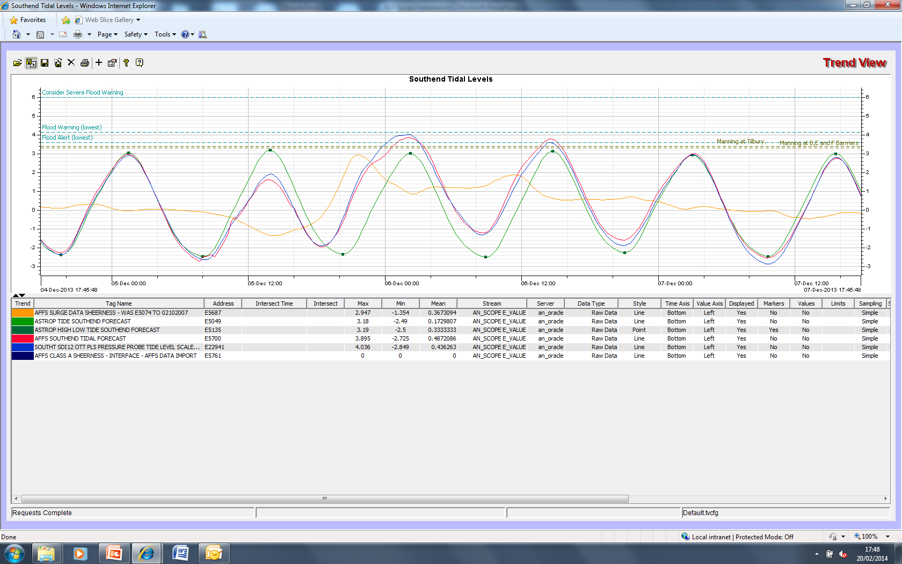
Notes:
Southend telemetry data with surge predictions ahead of the forecast and actual tides which reduced the potential impact to Essex.

Slide 13
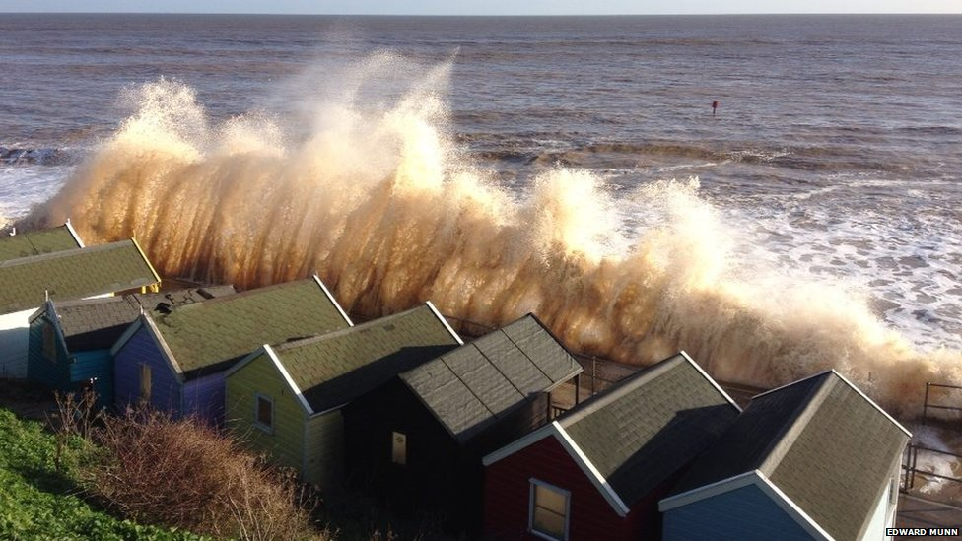
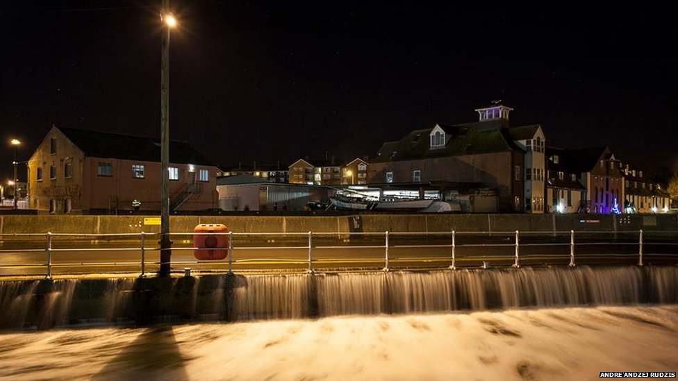
The event

Slide 14
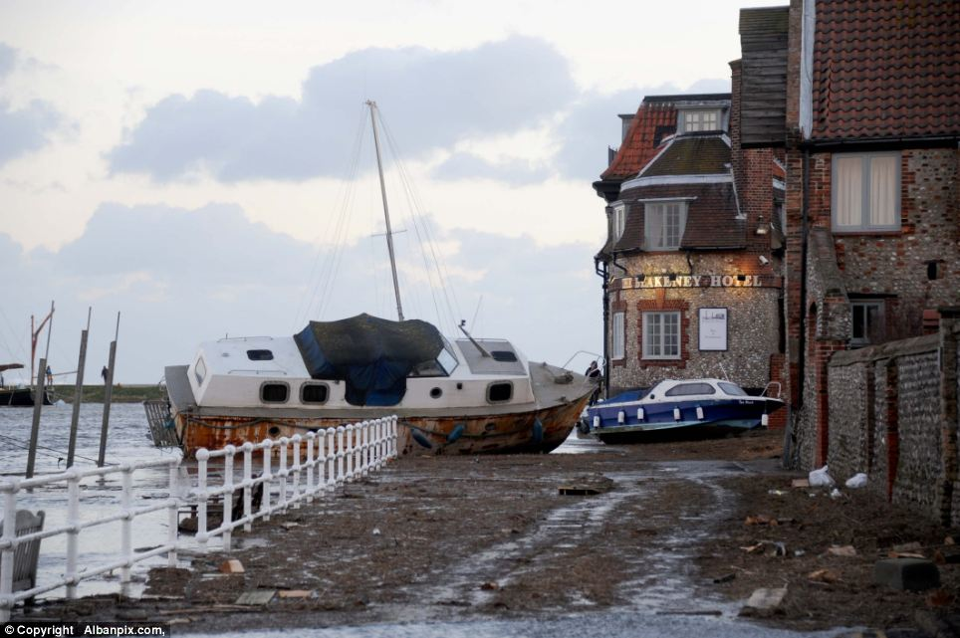
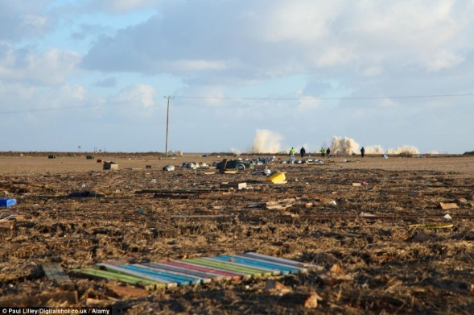
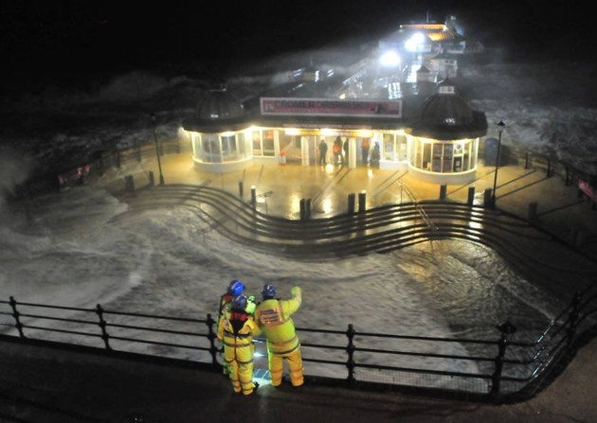
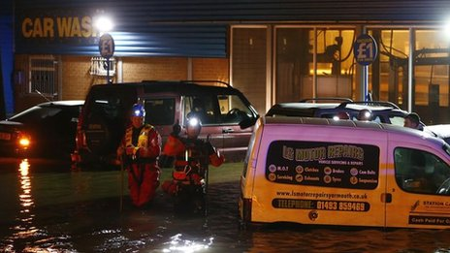
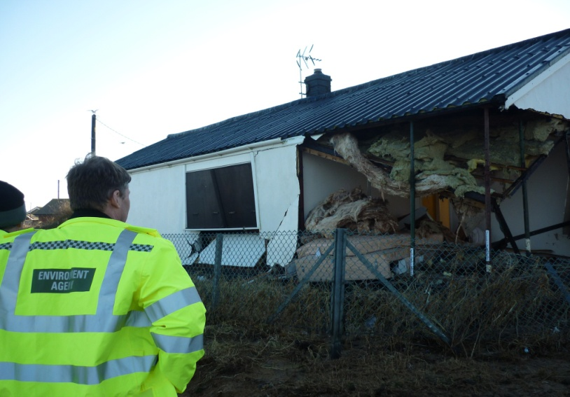

Slide 15
Preparing the operational response
Tues 3 December
Prepared Field Teams for event.
Weds 4 December
Mutual aid request for people and equipment.
Obtained additional equipment
Briefed contractors
Thurs 5 December
Deployment

Slide 16
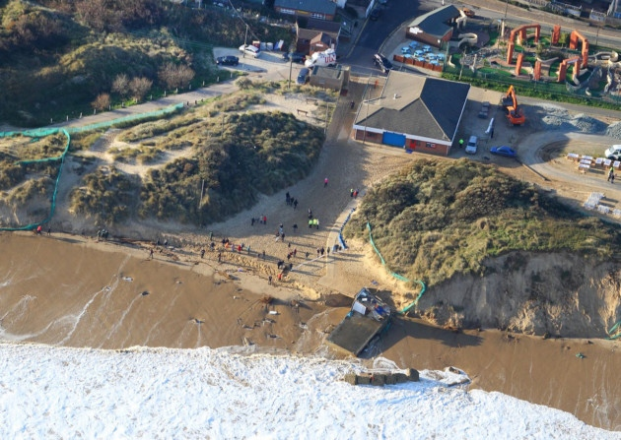
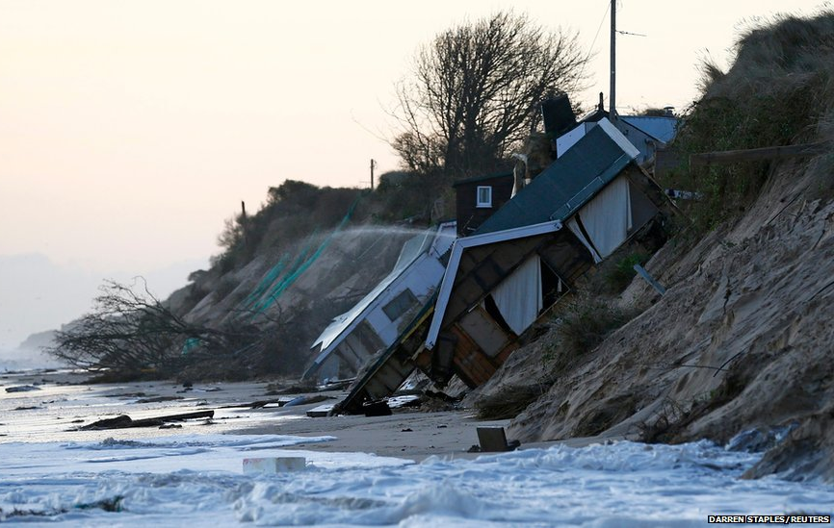
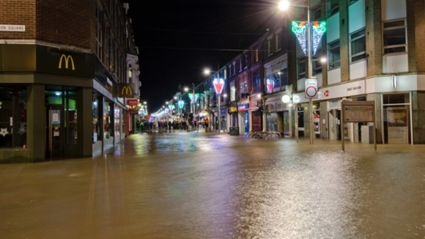
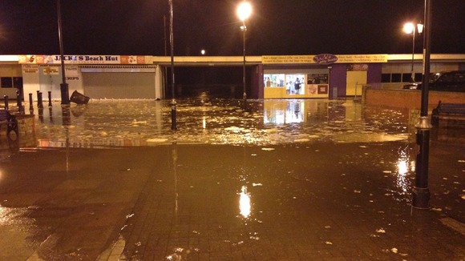
Impacts of the event

Slide 17
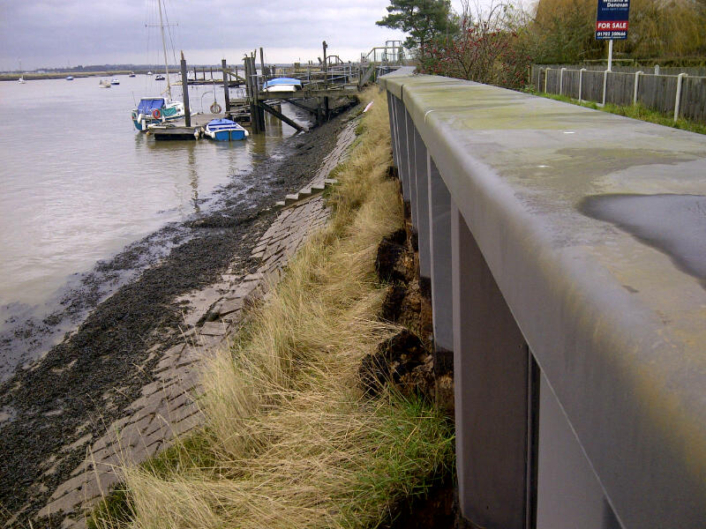
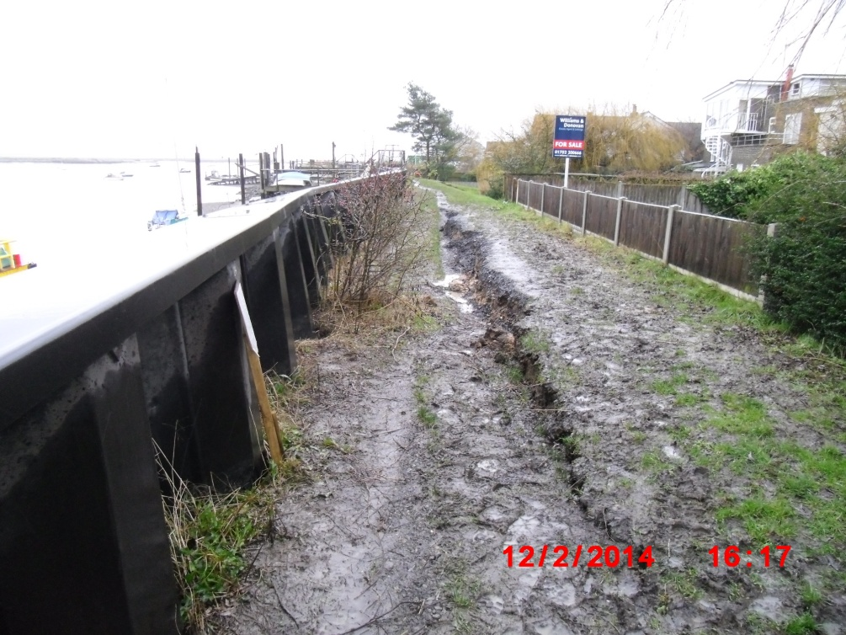
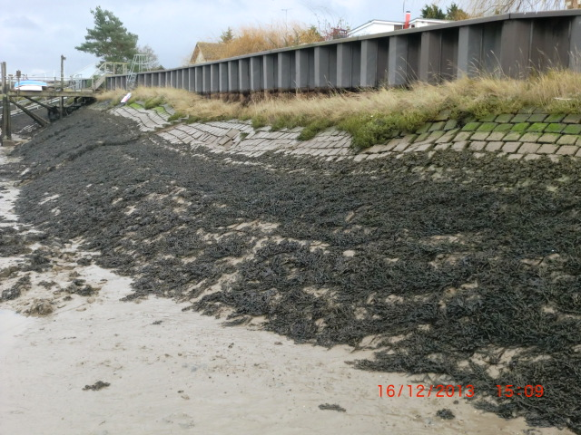
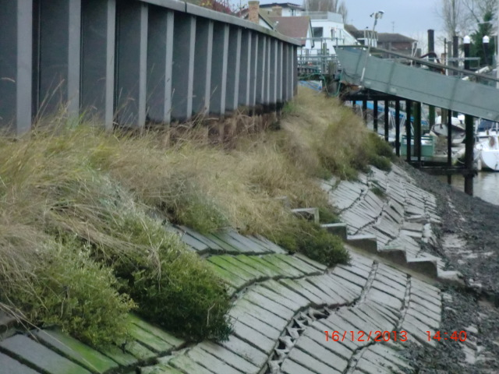
Essex Impacts - Hullbridge

Slide 18
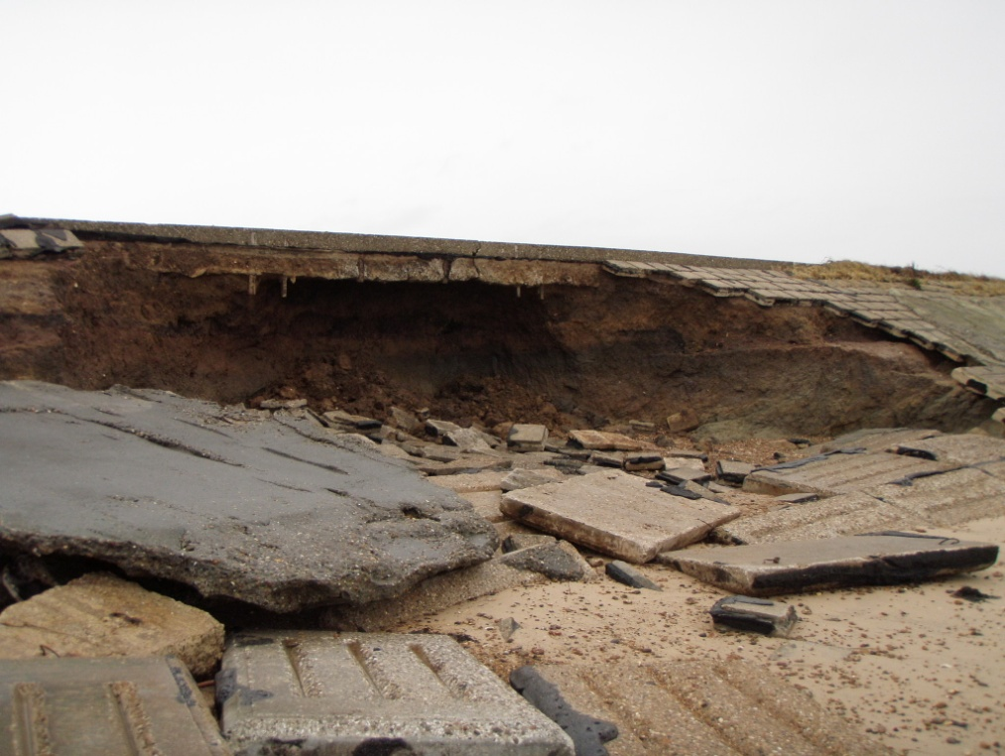
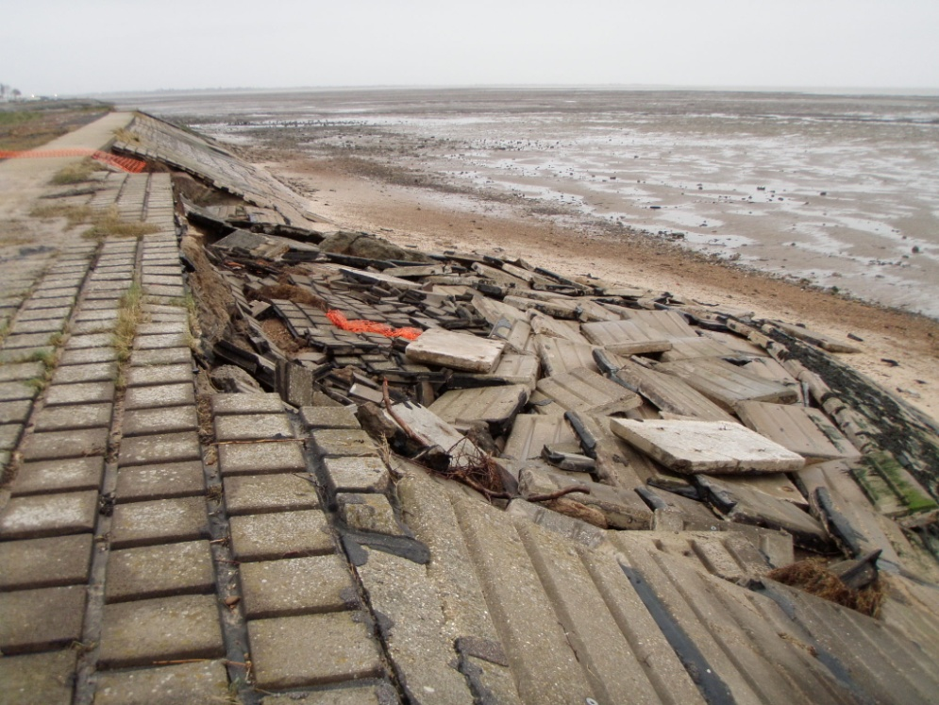
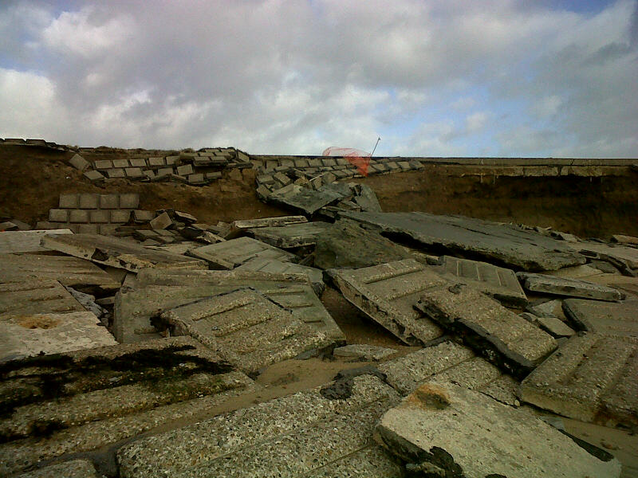
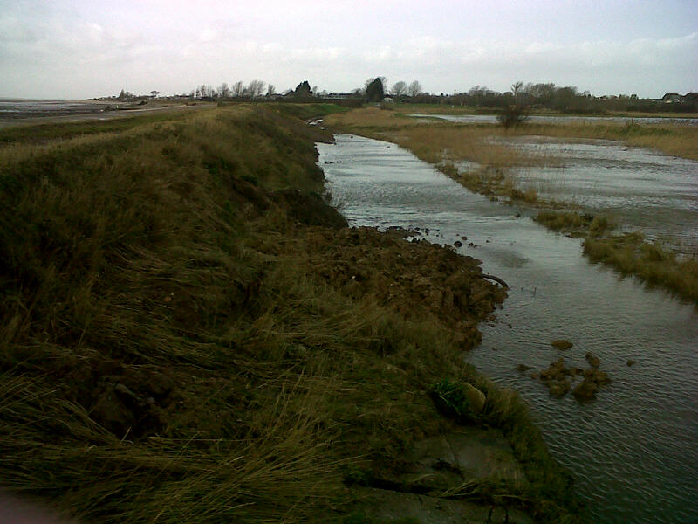
Essex Impacts-East Mersea

Slide 19
Comparison 1953 / 2013
 | 1953 | December 2013
Breaches | 1200 different locations | Under investigation
Properties flooded | 24,000 | 1,400 (10/12/2013)
Deaths | 307 | 2 but not flood related
Agricultural Land | 65,000 hectares | 6,800 hectares
People evacuated | 32,000 | 18,000
Infrastructure | 2 Power stations 12 Gas Works 100 miles of roads 200 miles of rail | Major impacts at Immingham Port No power stations and major gas works/services affected Road and rail tbc
Flood Warnings | 0 | 71 severe flood warnings Over 160, 000 warning messages sent directly to homes and businesses

Slide 20
Comparative Tide Heights
Monitoring Location | 1953 | 2013 | Estimated return period*
Wells-next-the-Sea | 5.13 m AODN | 5.215m AODN | 1:500
Great Yarmouth | 3.28m AODN | 3.318m AODN | 1:175
Lowestoft | 3.35m AODN | 3.291m AODN | 1:200
Felixstowe | 4.02m AODN | 3.447m AODN (Harwich) | 1:30
Holland | 4.05m AODN | 3.756m AODN (Clacton) | 1:30
Southend | 4.62m AODN | 4.10m AODN | 1:15
Tilbury | 4.85m AODN | 4.201m AODN | -
* Return period for 5th and 6th December taken from 2011 CFB Extreme Sea Levels.
Notes:
Valid only on 19th December 2013.

Slide 21
Essex Property Flooded Numbers
Community | Commercial | Residential | Total
Mistley and Manningtree | 11 | 1 | 12
Harwich | 1 | 0 | 1
Landermere Wharf/Quay | 2 | 0 | 2
Kirby le Soken | 0 | 2 | 2
Brightlingsea | 13 | 0 | 13
Great Bentley | 1 | 0 | 1
West Mersea | 2 | 2 | 4
Burnham on Crouch | 3 | 0 | 3
Total | 33 | 5 | 38
Notes:
Valid only on 19th December 2013.

Slide 22
Property Flooded Numbers – Summary
County | Commercial | Residential | Total
Norfolk | 52 | 218 | 270
Suffolk | 117 | 114 | 231
Essex | 33 | 5 | 38
Total | 202 | 337 | 539
Correct as of 1st February 2014
Notes:
Valid only on 19th December 2013.

Slide 23
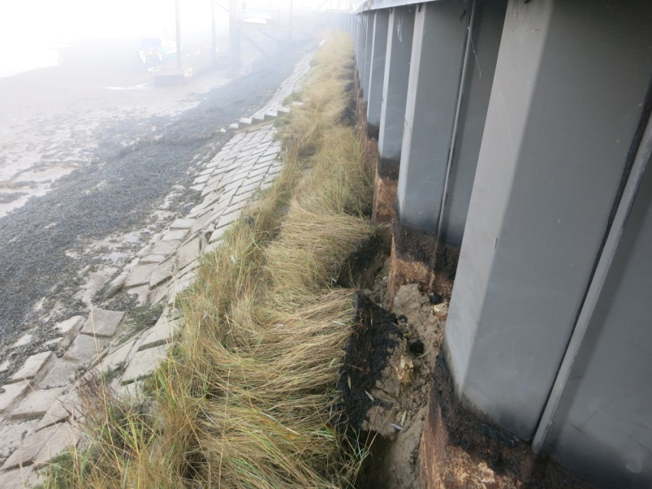
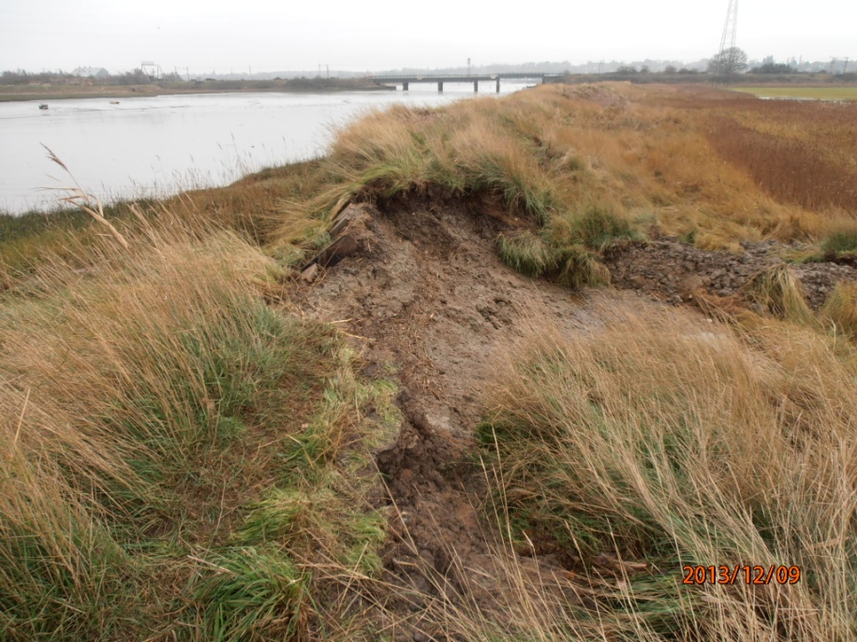
Prioritising the repairs
Friday
Using reports from public and our teams- deployed inspectors to priority areas.
Assessed immediate flood risk- deployed contractors and our engineers.
Saturday/ Sunday
Continuous inspections and planning.
Details reported to allow national prioritisation.
Hullbridge
Cattawade
Notes:
First photo- 6 December
Second 8 December

Slide 24
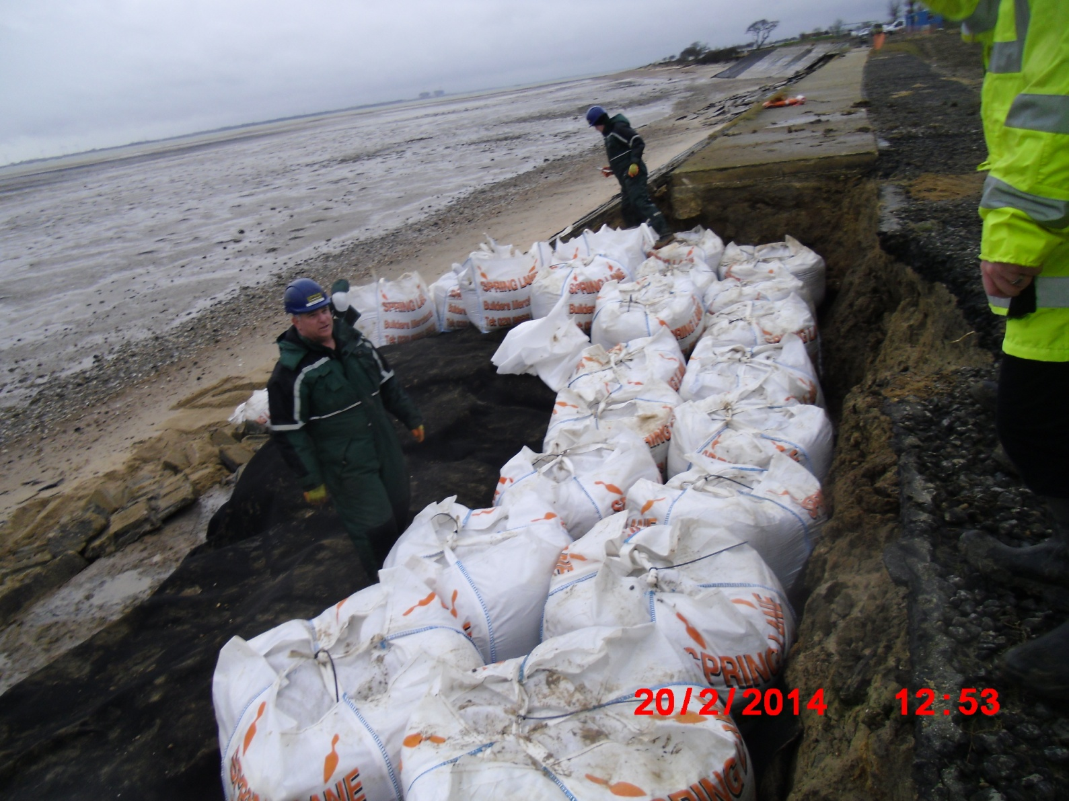
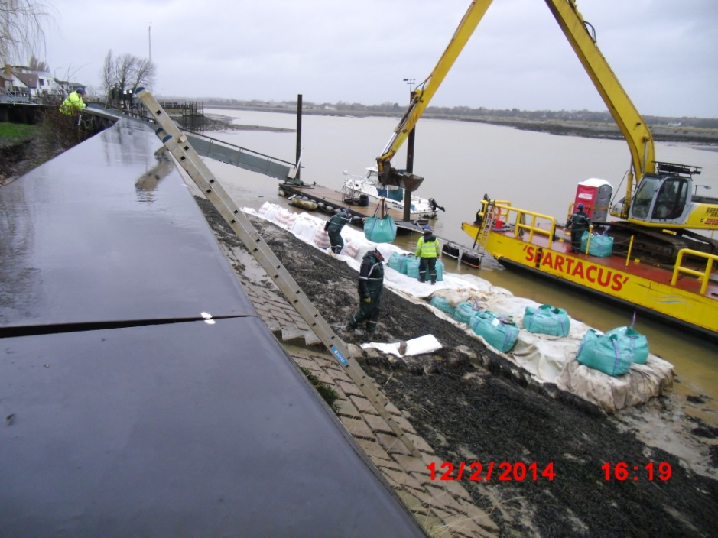
Undertaking repairs
Hullbridge – Pilling stabilisation
Rewsalls – Erosion protection
Notes:
First picture 7 December
Second- 17 December

Slide 25
Strategic decisions on intervention
Priority to protect life, property and land
Immediate response to priority sites
Other sites (Natura 2000 sites and farmland)
Careful consideration of technical feasibility and ensuring good value for money for British taxpayer

Slide 26
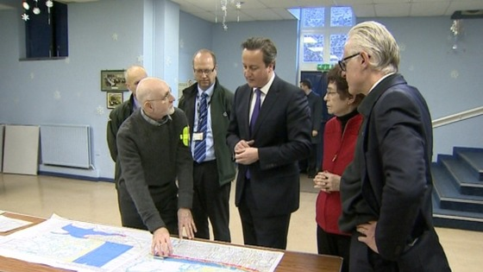
Feedback: Gold Controls and media
Nearly all positive
High level
Prime Minister
Secretary of State for Environment
Local Media
Norfolk Gold Control
NFU
Blyth Estuary Group
Coastal residents
MPs

Slide 27
Happy to take any questions

